Slide 1
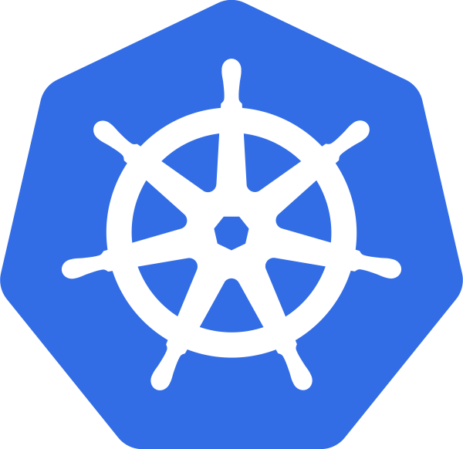
Seminar: First Steps with Kubernetes
SoftUni Team
Technical Trainers
Software University
https://softuni.org

Slide 2
About Me
Dimitar Zahariev
Technical trainer at SoftUni
Author and lecturer of the following courses:
Windows System Administration (Basic and Advanced)
Linux System Administration (Basic and Advanced)
DevOps (Basic and Fundamentals)
Azure Essentials

Slide 3
Have a Question?
sli.do
#Kubernetes
Notes:
3

Slide 4
Supporting Files
https://github.com
/shekeriev/softuni-k8s-seminar
Notes:
4

Slide 5
Table of Contents
The Journey
Architecture
Resources
Distributions
Tools
5
Notes:
5

Slide 6
The Journey to Kubernetes
Notes:
6

Slide 7
Containerization
“
OS-level virtualization refers to an operating system paradigm in which the kernel allows the existence of multiple isolated user space instances known as containers, zones, jails, …
”
https://en.wikipedia.org/wiki/OS-level_virtualization

Slide 8
Definitions
Container
Containers are processes with much more isolation
Image
Images provide a way for simpler software distribution
Writable Layer
A1
B2
Volume
MariaDB
B2
Layers
Ubuntu
A1
B1
Container

Slide 9
Road to Containers
Companies and Solutions
2004
Solaris Containers
(zones)
2011
Warden
By CloudFoundry
2000 - 2001
1) FreeBSD Jails
2) Virtuozzo
3) Linux VServer
2005
Virtuozzo OpenVZ
2007
HP-UX Containers
IBM WPAR
2013
Docker
By Docker Inc
2014
Rkt
By CoreOS
1979
chroot
1999
1) Capabilities
2) AppArmor
3) SELinux
2002
Mount Namespaces
2006
1) Process Containers (cgroups) by Google
2) UTS and IPC Namespaces
2008
1) cgroups in kernel
2) PID and Network Namespaces
3) User Namespace
4) LXC
Enablement Technologies

Slide 10
VMs vs Containers
VMs virtualize the hardware
Complete isolation
Complete OS installation. Require more resources
Run almost any OS
Containers virtualize the OS
Lightweight isolation
Shared kernel. Require fewer resources
Run on the same OS
…

Slide 11
Application Evolution *
Monolithic Applications
Microservices
Containers
Application
Client
MS5
CMS5
CMS4
CMS4
MS4
MS4
Server
CMS1
CMS1
CMS1
CMS2
CMS3
MS1
MS1
CDB1
CDB2
CDB3
MS1
MS2
MS3
Host 1
Single Container Host
Host 2
Host 3
Database
Database
DB1
DB2
DB3
Microservices != Containers
Notes:
11

Slide 12
Container Orchestration
Containerization brought new demands/requirements
Workload deployment and distribution
Resource governance
Scalability and availability
Automatization and management
Internal and external communication

Slide 13
Solutions
Docker Swarm
Apache Mesos + Marathon
Amazon Elastic Container Service (ECS)
HashiCorp Nomad
Kubernetes

Slide 14
Kubernetes Origin
Born out of projects like Borg and Omega at Google
Donated to CNCF in 2014
Open source, licensed under Apache 2.0
Written in Go
Version 1.0 came into existence in July 2015. Current is 1.18.5
κυβερνήτης in Greek means Helmsman – s.o. who steers the ship
Can be seen often as k8s
8
(Kubernetes)
(Kubernetes)

Slide 15
What Kubernetes Does?
Run a cluster of hosts
Schedule containers to run on different hosts
Facilitate the communication between the containers
Provide and control access to/from outside world
Track and optimize the resource usage

Slide 16
Kubernetes Architecture
Notes:
16

Slide 17
Architecture Overview
Kubernetes Cluster
Master Node
Master Node
Node 1
Node 2
Master Node
Pod 1
Pod 1
Proxy
Proxy
Scheduler
Kubelet
Pod n
Kubelet
Pod n
Controller
Node 3
Node 4
API Server
Pod 1
Pod 1
Proxy
Proxy
Key-Value Store
Kubelet
Pod n
Kubelet
Pod n

Slide 18
Masters (Control-plane Nodes)
Responsible for managing the cluster
Typically more than one is installed
In HA mode one Master node is the Leader
It is work-free (this can be changed)
Components running on master are also known as Control Plane
Can be reached via CLI (kubectl), APIs, or Dashboard
Master Node
Scheduler
Controller
API Server
Key-Value Store

Slide 19
Masters – Cluster Store
Based on etcd
Persistent storage
Cluster state and configuration
Distributed and consistent
Provides single source of truth
Can be installed externally
Master Node
Scheduler
Controller
API Server
Key-Value Store

Slide 20
Masters – API Server
Master Node
Front-end to the control plane
Administrative tasks
Exposes the API (REST)
Consumes JSON via Manifest files (YAML)
Scheduler
Controller
API Server
Key-Value Store

Slide 21
Masters – Controller
Executes control loops
Responsible for other controllers
Node controller
Endpoints controller
Namespace controller, and etc.
Watches for changes
Maintains the desired state
Master Node
Scheduler
Controller
API Server
Key-Value Store

Slide 22
Masters – Scheduler
Master Node
Scheduler
Listens API Server for new work
Assigns work to nodes
Controller
API Server
Key-Value Store

Slide 23
(Worker) Nodes
Initially called Minions
Container runtime
Docker, containerd, CRI-O, etc.
Kubelet
Communicates with master
Uses CRI shims
kube-proxy
Network proxy
Node 1
Proxy
Kubelet
Container Runtime
Pod 1
Pod 2

Slide 24
(Worker) Nodes – Container Runtime
Container management:
Pulling images
Starting and stopping
It is pluggable
By default is Docker
Node 1
Proxy
Kubelet
Container Runtime
Pod 1
Pod 2

Slide 25
(Worker) Nodes – Kubelet
Main Kubernetes agent
Registers node in the cluster
Listens to API Server
Creates pods
Reports back to the master
Exposes endpoint on :10255
/spec
/healthz
/pods
Node 1
Proxy
Kubelet
Container Runtime
Pod 1
Pod 2

Slide 26
(Worker) Nodes – Kube Proxy
Provides the networking
Each pod has its own address
All containers in a pod share the same IP address
Offers load balancing across all pods in a service
Node 1
Proxy
Kubelet
Container Runtime
Pod 1
Pod 2

Slide 27
Basic Resources
Notes:
27

Slide 28
Kubernetes Objects
Kubernetes objects are persistent entities
They are used to represent the state of the cluster
An object is a "record of intent". Once created, the Kubernetes system will constantly work to ensure that object exists
Almost every object includes two nested object fields
Spec provides a description of the characteristics (desired state)
Status describes the current state of the object
They include Pods, Services, Namespaces, Volumes, etc.
https://kubernetes.io/docs/concepts/overview/working-with-objects/kubernetes-objects/

Slide 29
Namespaces
Kubernetes supports multiple virtual clusters
These virtual clusters are called namespaces
Namespaces provide a scope for names
Names of resources need to be unique within a namespace
Namespaces cannot be nested inside one another
Each Kubernetes resource can only be in one namespace
Most Kubernetes resources are in some namespace
Namespace resources are not themselves (and others such as nodes) in a namespace
Deleting a Namespace will clean up everything under it
https://kubernetes.io/docs/concepts/overview/working-with-objects/namespaces/

Slide 30
Pods (1)
Smallest unit of scheduling
One or more containers
Containers share the pod environment
Scheduled on nodes
It is atomic – deployed as one and on one node
Created via manifest files
Pod
Environment
…
mount
net
Main container
Supporting containers
https://kubernetes.io/docs/concepts/workloads/pods/

Slide 31
Pods (2)
Pod 1
Pod 2
localhost
localhost
10.10.20.20
10.10.20.21
Pod Network
Each pod has a unique IP address
Inter-pod communication is via a pod network
Intra-pod communication is via localhost and port

Slide 32
Replication Controllers
Higher level workload
Looks after pod or set of pods
Scale up/down pods
Sets Desired State
Rarely used these days
ReplicationController
Pod
https://kubernetes.io/docs/concepts/workloads/controllers/replicationcontroller/

Slide 33
Replica Sets
Higher level workload
Looks after pod or set of pods
Scale up/down pods
Sets Desired State
Preferred over Replication Controllers
Rarely used alone by itself
ReplicaSet
Pod
https://kubernetes.io/docs/concepts/workloads/controllers/replicaset/

Slide 34
Deployments
Even higher level workload
Simplifies updates and rollbacks
Declarative and imperative approach
Self documenting
Suitable for versioning
Deployment
ReplicaSet
Pod
https://kubernetes.io/docs/concepts/workloads/controllers/deployment/

Slide 35
Services
Provide reliable network endpoint
IP address
DNS name
Port
Expose Pods to the outside world
NodePort (cluster-wide port)
LoadBalancer (cloud-based)
Use End Point object to track Pods
Pod A IP, Pod B IP, …
IP: 10.10.10.1
DNS: demo-svc
Port: 32001
End Point
Service
Node 1
Node 2
Pod A
Pod B
10.10.20.21
10.10.20.22
https://kubernetes.io/docs/concepts/services-networking/service/

Slide 36
Services in Action
Services user label selectors to do their magic
Service
app = myapp
version = v01
Pod
app = myapp
version = v01
Initial deployment – one pod with version = v01

Slide 37
Services in Action
Services user label selectors to do their magic
Service
app = myapp
version = v01
Pod
Pod
Pod
app = myapp
app = myapp
app = myapp
version = v01
version = v01
version = v01
Scale up – two more pods with version = v01

Slide 38
Services in Action
Services user label selectors to do their magic
Service
app = myapp
version = v01
Pod
Pod
app = myapp
app = myapp
version = v01
version = v01
Scale down – remove one pod and end up with two pods with version = v01

Slide 39
Services in Action
Services user label selectors to do their magic
Service
app = myapp
version = v01
Pod
Pod
Pod
Pod
app = myapp
app = myapp
app = myapp
app = myapp
version = v01
version = v02
version = v02
version = v01
Next step – add two more pods with version = v02

Slide 40
Services in Action
Services user label selectors to do their magic
Service
app = myapp
version = v02
Pod
Pod
Pod
Pod
app = myapp
app = myapp
app = myapp
app = myapp
version = v01
version = v02
version = v02
version = v01
Next step – we update the service to look for version = v02

Slide 41
Services in Action
Services user label selectors to do their magic
Service
app = myapp
version = v02
Pod
Pod
app = myapp
app = myapp
version = v02
version = v02
Finally, all pods with version = v01 are destroyed

Slide 42
Kubernetes Distributions
Notes:
42

Slide 43
Kubernetes Distributions
A Kubernetes distribution is a software package that provides a pre-built version of Kubernetes
Most distributions also offer installation tools or additional software integrations
On-premise
Minikube, MicroK8s, K3s, k0s, openSUSE Kubic, OpenShift, …
Cloud-based
Azure Kubernetes Services (AKS), Elastic Container Service for Kubernetes (EKS), Google Kubernetes Engine (GKE), …
Usually, cloud versions are a few versions behind
Notes:
43

Slide 44
Kubernetes Installation and Tools
Notes:
44

Slide 45
Installation. Configuration. Tools
Installation methods
Localhost (Minikube, Ubuntu on LXD)
On-Premise (VMs, Bare Metal)
Cloud (Hosted Solutions, Turnkey Solutions, Bare Metal)
Configurations
All-in-One Single Node and Different Multi Node Options
Installation tools
kubeadm, KubeSpray, Kops

Slide 46
kubeadm
Can create a minimum viable Kubernetes cluster that conforms to best practices
Provides other cluster lifecycle functions, such as bootstrap tokens and cluster upgrades
Supports integration with provisioning systems such as Ansible or Terraform
https://kubernetes.io/docs/setup/production-environment/tools/kubeadm/install-kubeadm/
Notes:
46

Slide 47
kubectl
Controls the Kubernetes cluster manager
Expects a file named config in the $HOME/.kube directory
Other files can be specified by setting the KUBECONFIG environment variable or by setting the --kubeconfig flag
The syntax is
Where command is the operation (run, get, etc.) and type is the resource (pod, service, etc.). Note that name is case-sensitive
kubectl [command] [TYPE] [NAME] [flags]
https://kubernetes.io/docs/tasks/tools/install-kubectl/
Notes:
47

Slide 48
minikube
Easiest and recommended way for a local all-in-one cluster
Requirements
kubectl
Hypervisor (VirtualBox, Hyper-V, KVM, xhyve, VMware Fusion)
VT-x/AMD-v enabled
Internet connection on the first run
Supports Linux, macOS, and Windows
Provides docker-machine-like experience, but for Kubernetes
https://minikube.sigs.k8s.io/docs/start/

Slide 49
Dashboard
A web-based Kubernetes user interface
Deployment of containerized applications to a cluster
Troubleshooting containerized application
Managing the cluster resources
https://kubernetes.io/docs/tasks/access-application-cluster/web-ui-dashboard/
Notes:
49

Slide 50
Lens IDE
Standalone desktop application for macOS, Windows, and Linux
Multi cluster management of local and remote clusters
Organize clusters into logical groups (workspaces)
Built-in Prometheus stats
Context aware terminal with kubectl
Built-in Helm charts management
https://k8slens.dev/
Notes:
50

Slide 51

Demo Time
Let’s See It in Action
Notes:
51

Slide 52

Summary
…
Notes:
52

Slide 53
Questions?
Notes:
53

Slide 54


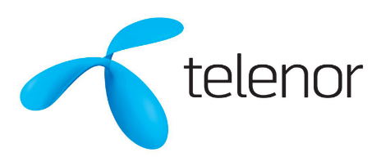



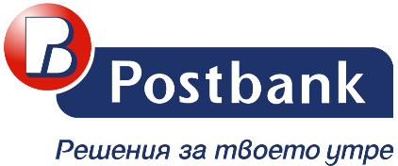



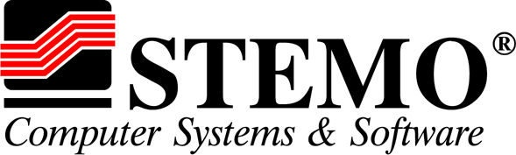

SoftUni Diamond Partners
Notes:
54

Slide 55

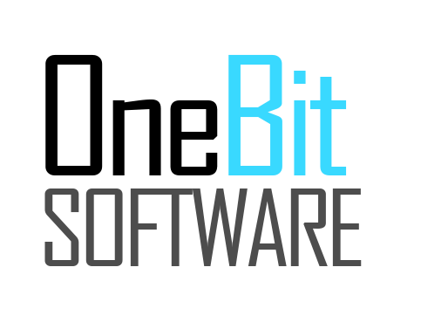


SoftUni Organizational Partners
Notes:
55

Slide 56

License
This course (slides, examples, demos, exercises, homework, documents, videos and other assets) is copyrighted content
Unauthorized copy, reproduction or use is illegal
© SoftUni – https://softuni.org
© Software University – https://softuni.bg
Notes:
56

Slide 57
Trainings @ Software University (SoftUni)
Software University – High-Quality Education, Profession and Job for Software Developers
softuni.bg, softuni.org
Software University Foundation
softuni.foundation
Software University @ Facebook
facebook.com/SoftwareUniversity
Software University Forums
forum.softuni.bg
Notes:
57

